Slide 1
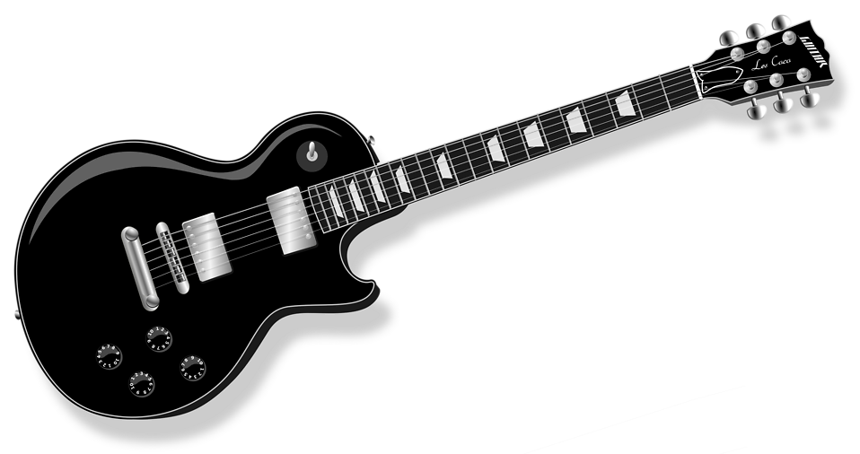
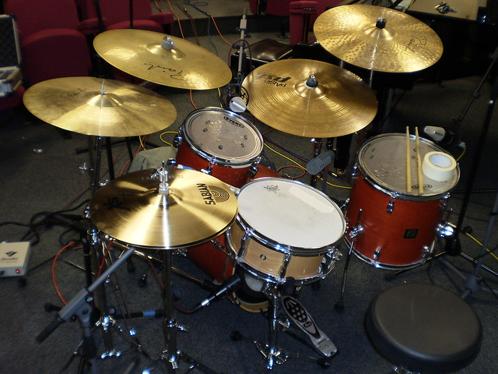
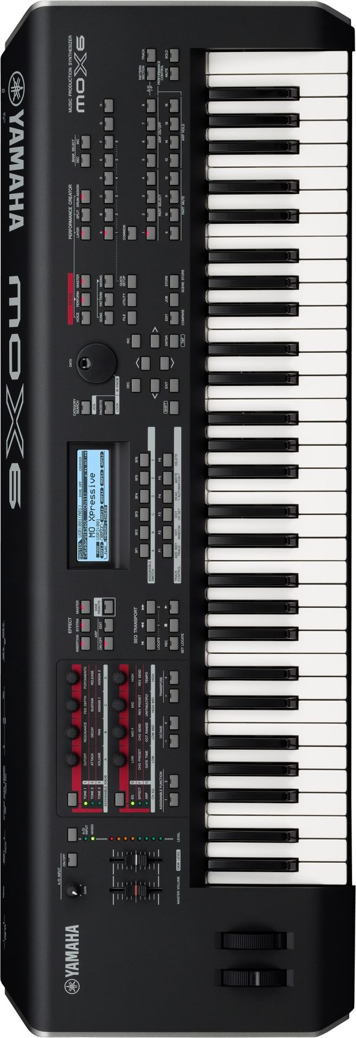
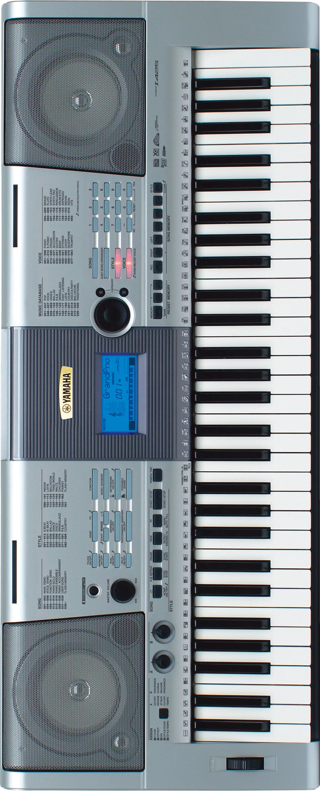
Kickin Nash Stage Plot
2 Stereo Keyboards. 4 Channels required. Will hand Sound company left and right XLRs or ¼ in for each board.
6 String Gtr left of drums
112 combo amp mic’d to FOH
Drum Mic Requirements
Internal kick drum mic is permanently mounted inside drum
Need mics for Snare, 2 rack toms and 1 floor tom
1 overhead and hihat condenser mics I have drum mics, lmk if you want me to bring
Bass Gtr right of drums
Direct xlr to FOH from bass amp
Details:
Band runs personal IEM’s
Band provides splitter to FOH
Drums: 8 channels
Bass: 1 channel (DI)
Keys: 4 channels (2X stereo DI)
Lead Gtr: 1 channel (mic)
Rhythm Gtr: 1 channel (DI)
Acoustic Gtr: 1 channel (DI)
Lead Vox: 2 channels (wireless)
BGV’s: 4 channels (house mics)
2 channels req’d for singer’s elec/acoustic guitar’s which run DI to FOH. Uses his own wireless mic
Female singer uses her own wireless mic
Vocal Mic for Bassist (House Mic)
Vocal Mic for Keyboardist (House Mic)
Vocal Mic for Guitarist (House Mic)
Kickin Nash:
GregNunz@Verizon.net
732 539 6050
www.kickinnashnj.com

